Slide 1




Unit
7
DANGER Lesson 2: Not as dangerous as you think

Slide 2

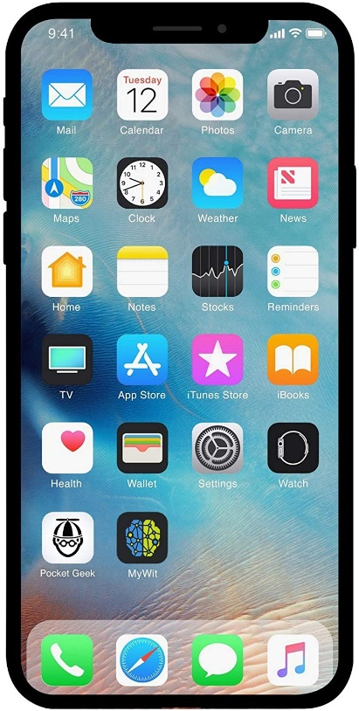
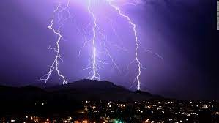
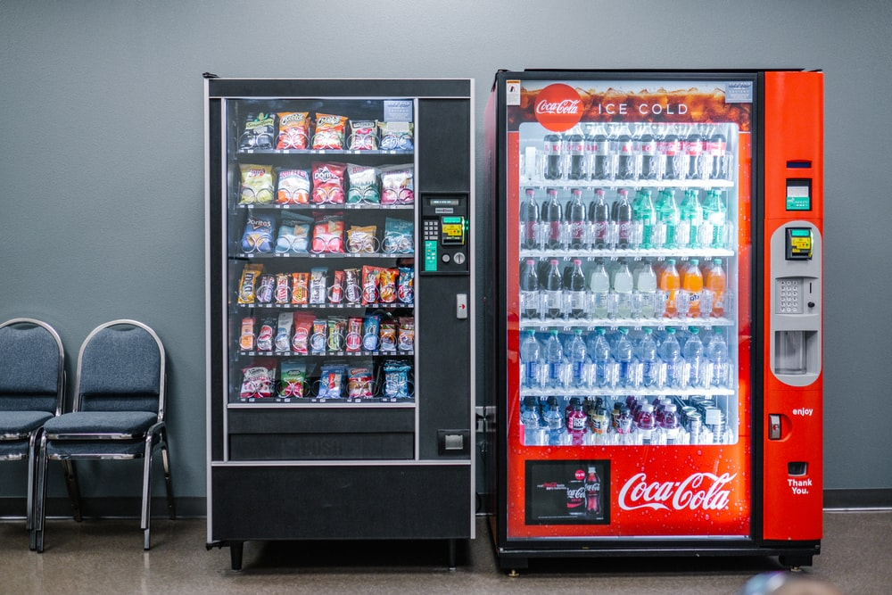
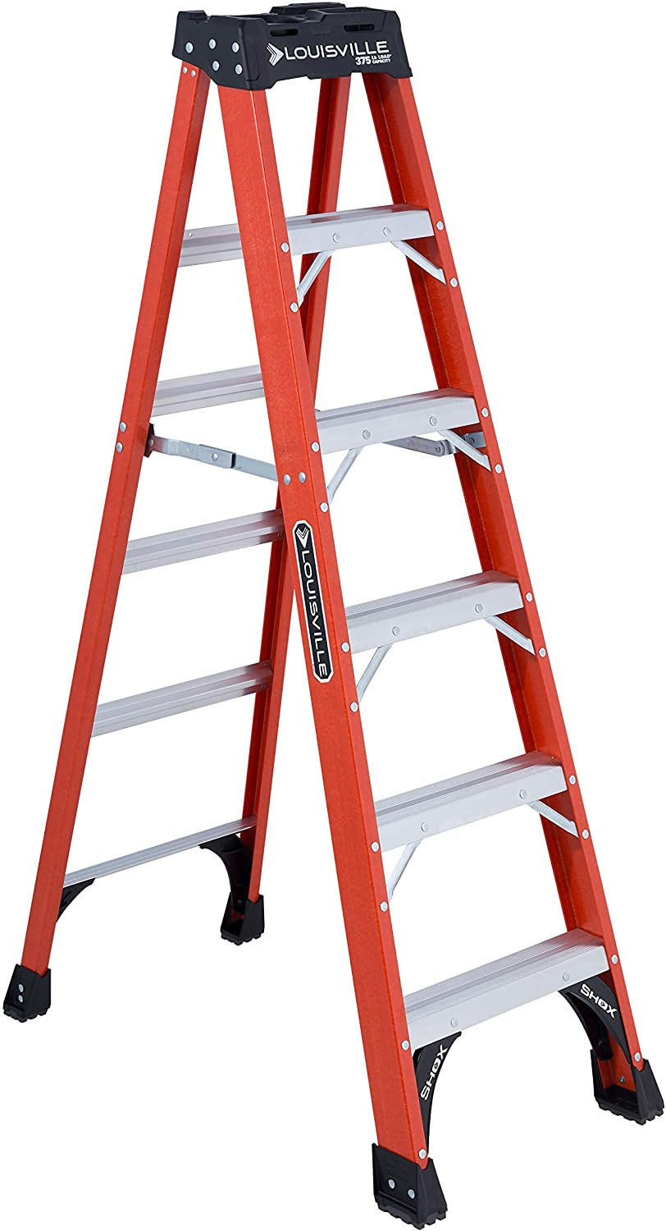
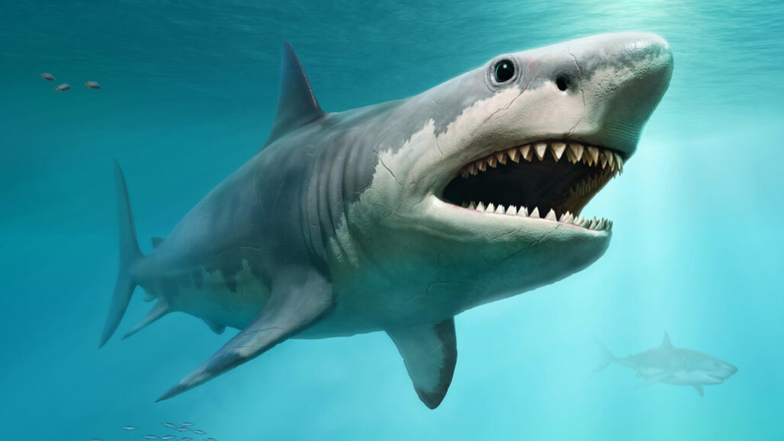
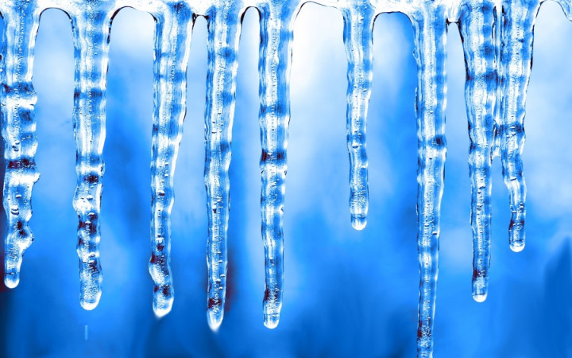
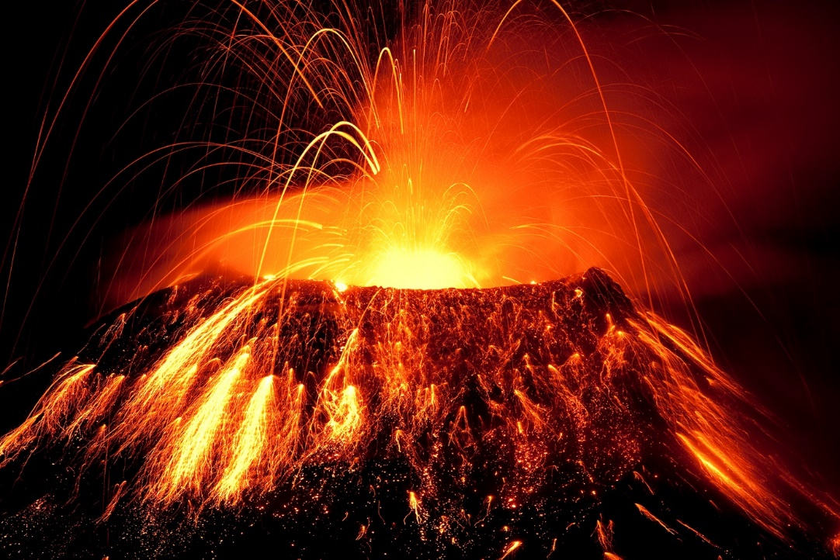
Unit 7: DANGER
Lesson 2: Not as dangerous as you think
Are these things dangerous?
SPEAKING
Dangerous things
lightning /ˈlaɪtnɪŋ/
vending machine
bed
shark
icicle
/ˈaɪ.sɪ.kəl/
volcano
/vɒlˈkeɪ.nəʊ/
ladder
/ˈlæd.ər/

Slide 3
Unit 7: DANGER
Lesson 2: Not as dangerous as you think
In what ways do you think
they could be dangerous?
SPEAKING
Dangerous things
lightning /ˈlaɪtnɪŋ/
vending machine
bed
shark
icicle
volcano
ladder

Slide 4
Unit 7: DANGER
Lesson 2: Not as dangerous as you think
Which do you think is the most dangerous?
SPEAKING
Dangerous things
lightning /ˈlaɪtnɪŋ/
vending machine
bed
shark
icicle
/ˈaɪ.sɪ.kəl/
volcano
/vɒlˈkeɪ.nəʊ/
ladder
/ˈlæd.ər/

Slide 5

READING
Some surprising statistics
Which animal is more dangerous?

Slide 6
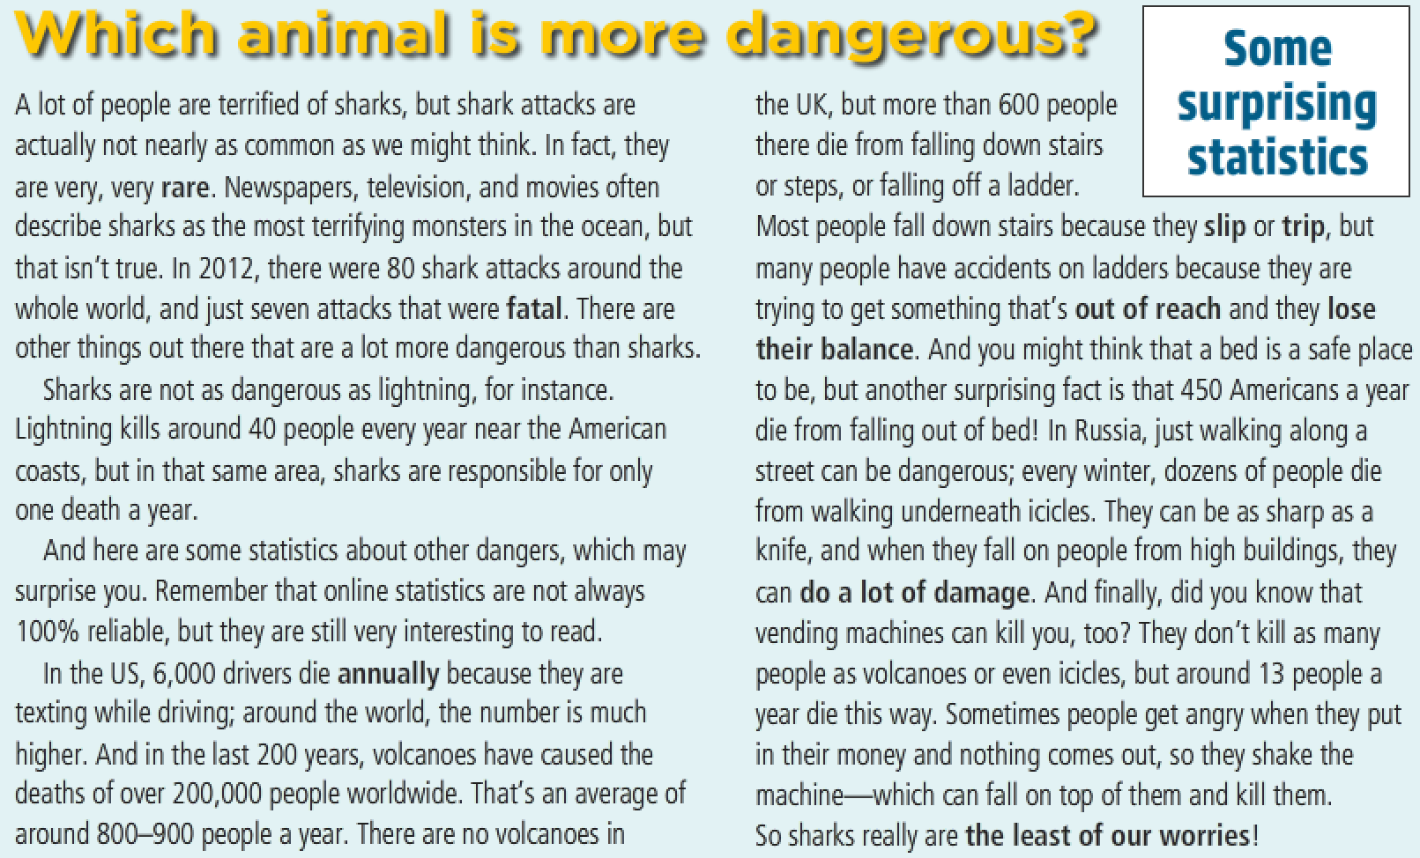
Read the article and find out if your predictions were correct.

Slide 7
Unit 7: DANGER
Lesson 2: Not as dangerous as you think
READING
Some surprising statistics
Lightning could kill you if it hits you.
A vending machine could fall on you.
You could cause a crash by using your cell phone while driving.
You could fall out of bed.

Slide 8
Unit 7: DANGER
Lesson 2: Not as dangerous as you think
READING
Some surprising statistics
A shark could attack you.
Icicles could fall on you and injure you.
A volcano could kill you if it erupted.
You could fall off a ladder.

Slide 9
Which animal is more dangerous?
A lot of people are terrified of sharks, but shark attacks are actually not nearly as common as we might think. In fact, they are very, very rare. Newspapers, television, and movies often describe sharks as the most terrifying monsters in the ocean, but that isn't true. In 2012, there were 80 shark attacks around the whole world, and just seven attacks that were fatal. There are other things out there that are a lot more dangerous than sharks.
Sharks are not as dangerous as lightning, for instance. Lightning kills around 40 people every year near the American coasts, but in that same area, sharks are responsible for only one death a year.
And here are some statistics about other dangers, which may surprise you. Remember that online statistics are not always 100% reliable, but they are still very interesting to read.
In the US, 6,000 drivers die annually because they are texting while driving; around the world, the number is much higher. And in the last 200 years, volcanoes have caused the deaths of over 200,000 people worldwide. That's an average of around 800-900 people a year. There are no volcanoes in the UK, but more than 600 people surprising there die from falling down stairs statistics or steps, or falling off a ladder. Most people fall down stairs because they slip or trip, but many people have accidents on ladders because they are trying to get something that's out of reach and they lose their balance. And you might think that a bed is a safe place to be, but another surprising fact is that 450 Americans a year die from falling out of bed! In Russia, just walking along a street can be dangerous; every winter, dozens of people die from walking underneath icicles. They can be as sharp as a knife, and when they fall on people from high buildings, they can do a lot of damage. And finally, did you know that vending machines can kill you, too? They don't kill as many people as volcanoes or even icicles, but around 13 people a year die this way. Sometimes people get angry when they put in their money and nothing comes out, so they shake the machine—which can fall on top of them and kill them. So sharks really are the least of our worries!

Slide 10
Bold words | Meaning
1. rare | a) every year
2. fatal | b) fall or nearly fall
3. annually | c) in a place where you can’t get it
4. slip | d) cause a lot of harm
5. trip | e) the thing we shouldn’t worry about
6. out of reach | f) not happening very often
7. lose their balance | g) causing death
8. do a lot of damage | h) when you fall or loose your balance
9. the least of our worries | i) slide without intending to

Slide 11
Bold words | Meaning
1. rare
2. fatal
3. annually
4. slip
5. trip
6. out of reach
7. lose their balance
8. do a lot of damage
9. the least of our worries
f) not happening very often
g) causing death
a) every year
i) slide without intending to
h) when you fall or loose your balance
c) in a place where you can’t get it
b) fall or nearly fall
d) cause a lot of harm
e) the thing we shouldn’t worry about

Slide 12
Unit 7: DANGER
Lesson 2: Not as dangerous as you think
READING
Some surprising statistics
Read the article and answer the questions.
1. What, according to the article, is the most dangerous thing we can do?
→ Drive a _____________ while texting on a __________________.
2. What's the next most likely cause of death?
→ _____________________________________________
3. What's the least dangerous thing mentioned in the article?
→ _____________________________________________
4. Why are icicles dangerous?
→ They ________ on people from _________________ and can do a lot of _____________ because they're _______________.
5. How can a vending machine kill someone?
→ If it ____________ on you because you ____________ it.
car
cell phone
Volcanoes
Sharks
fall
high buildings
damage
sharp
falls
shake
Notes:
Ask fast finishers to find out extra information from the text, e.g., the numbers of people who die from: vending machines, car accidents, volcanoes, falling down stairs, shark attacks, falling out of bed, and walking in winter

Slide 13
GRAMMAR
Comparison
(not) as …. as

Slide 14
Unit 7: DANGER
Lesson 2: Not as dangerous as you think
GRAMMAR
Comparison: (not) as … as
Comparison: (not) as … as
1. We use as … as to show things are equal.
2. We use not as … as to show two things are unequal.

Slide 15
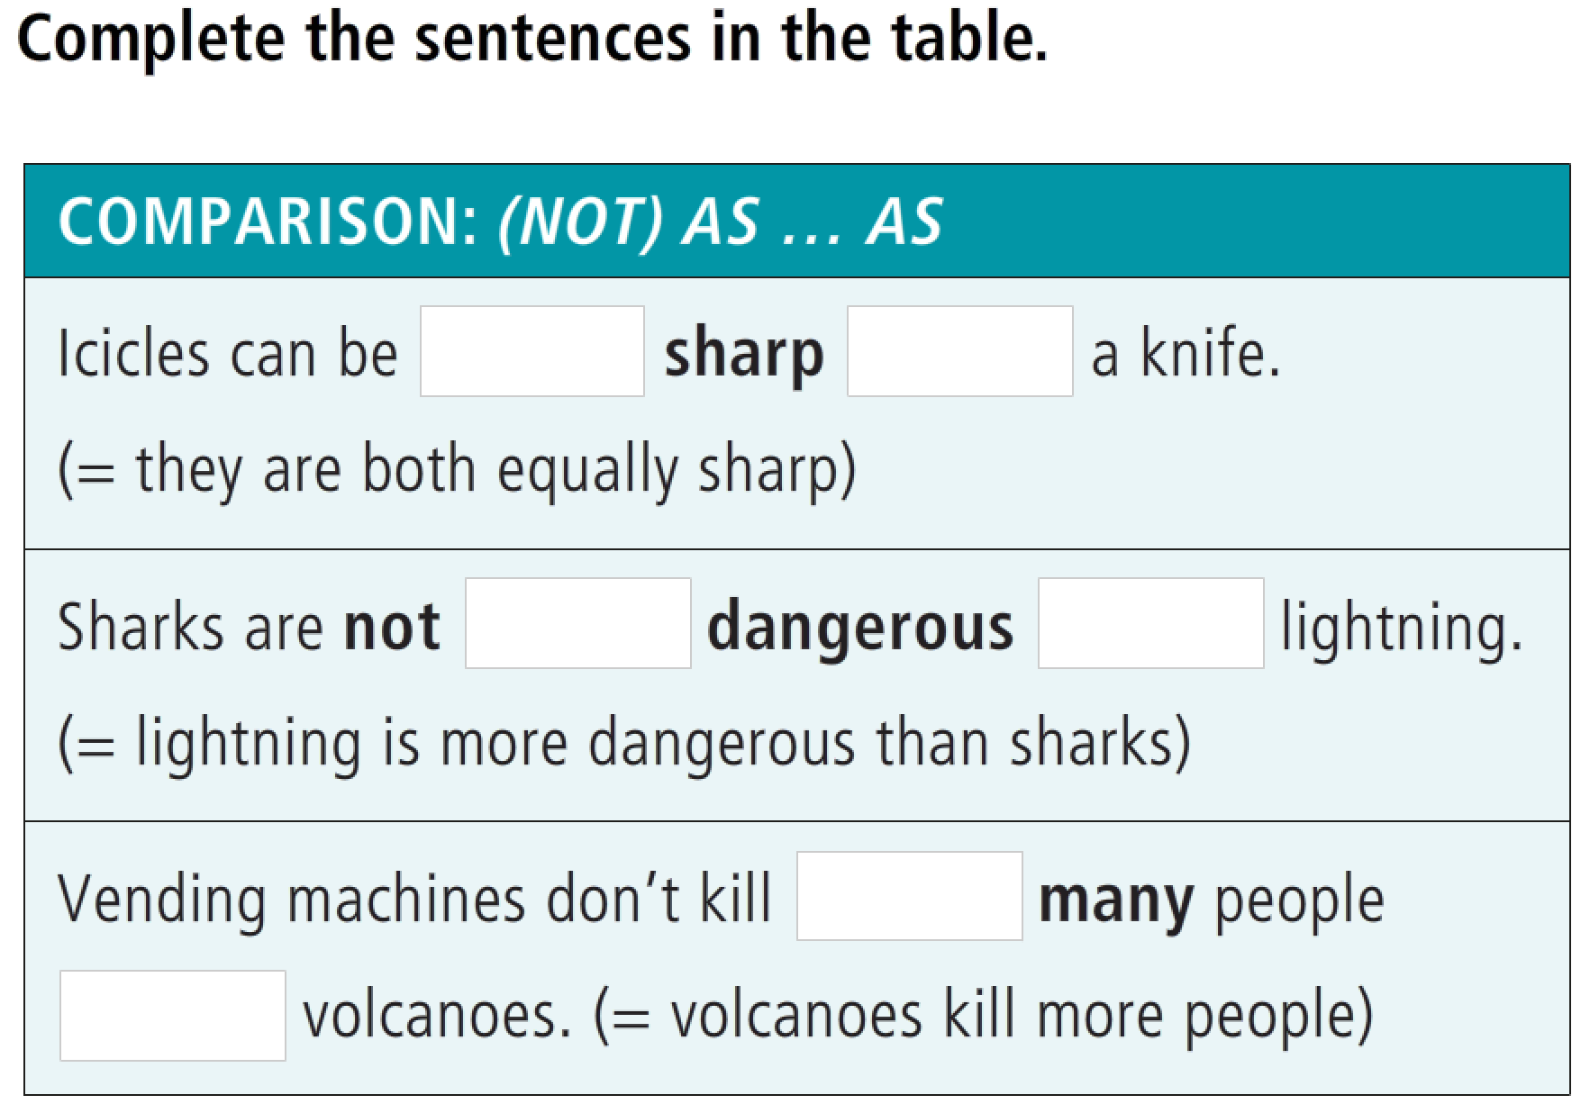
Unit 7: DANGER
Lesson 2: Not as dangerous as you think
GRAMMAR
Comparison: (not) as … as

Slide 16
Unit 7: DANGER
Lesson 2: Not as dangerous as you think
GRAMMAR
Comparison: (not) as … as
as
as
as
as
as
as

Slide 17
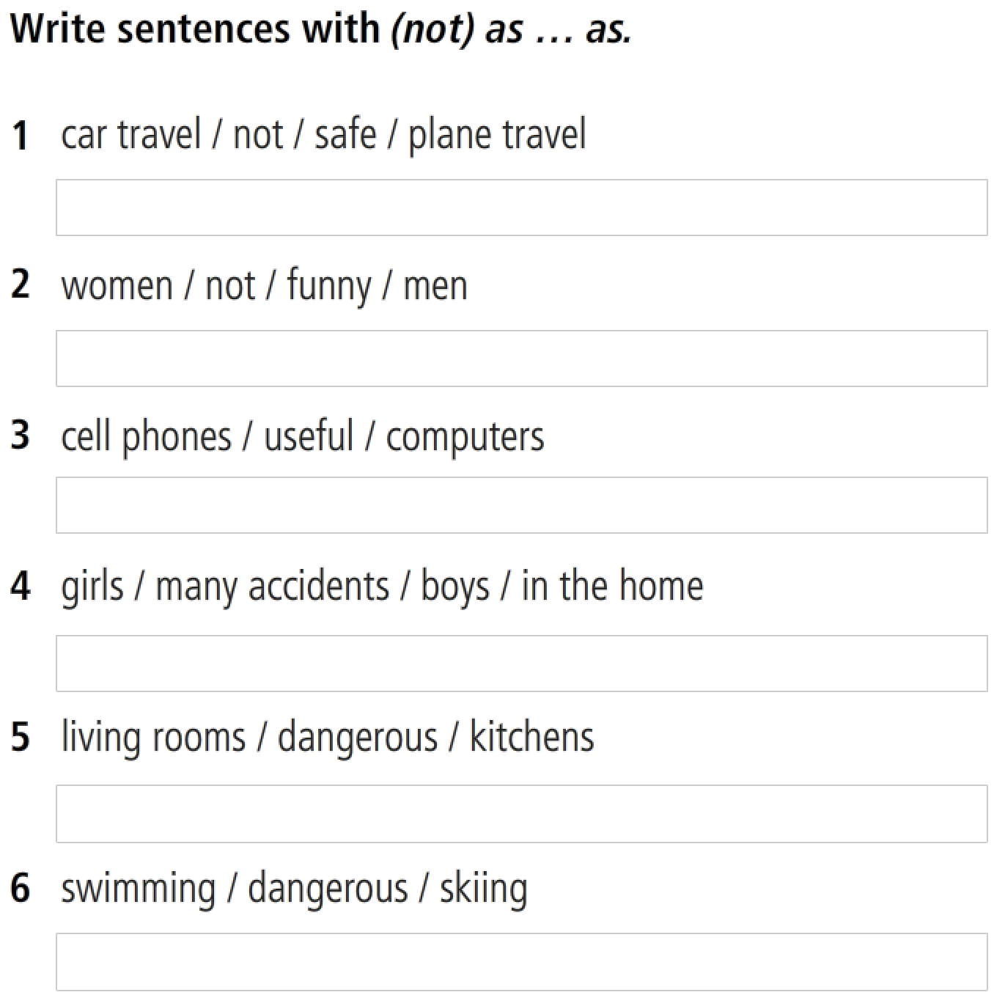
Unit 7: DANGER
Lesson 2: Not as dangerous as you think
GRAMMAR
Comparison: (not) as … as
Car travel isn’t as safe as plane travel.
Women aren’t as funny as men.
Cell phones are as useful as computers.
Girls have as many accidents as boys in the home.
Living rooms are as dangerous as kitchens.
Swimming is as dangerous as skiing.

Slide 18

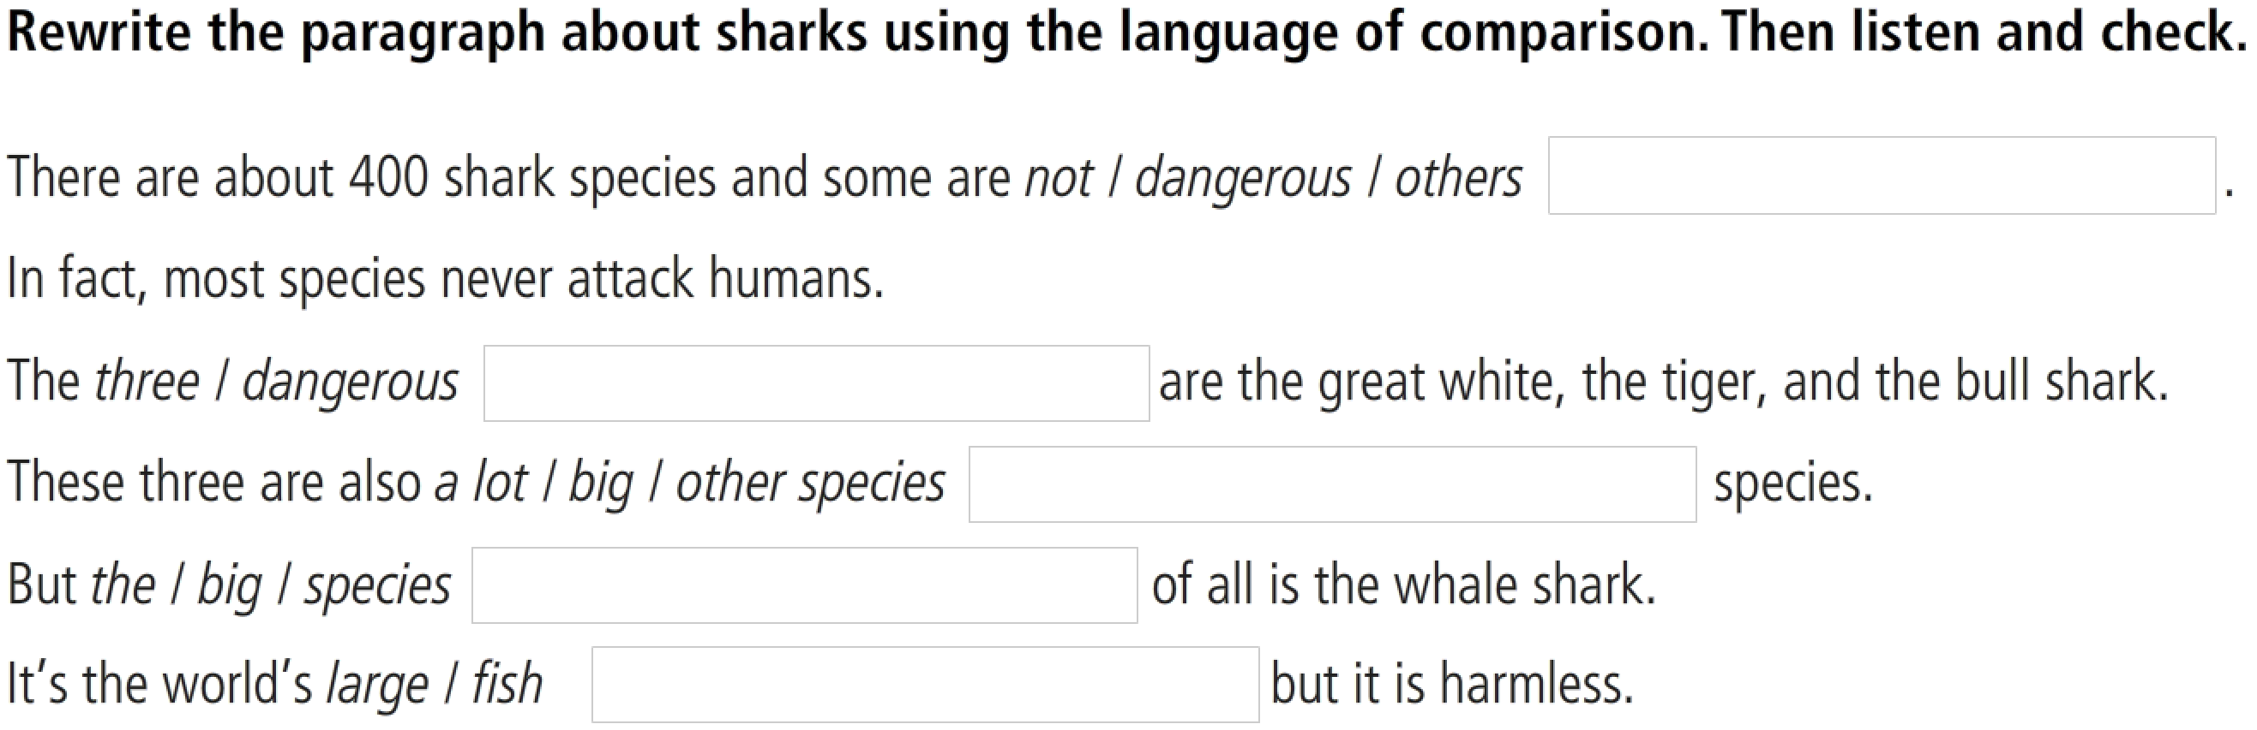
Unit 7: DANGER
Lesson 2: Not as dangerous as you think
GRAMMAR
Comparison: (not) as … as
not as dangerous as others.
three most dangerous
a lot bigger than other
the biggest species
largest fish

Slide 19
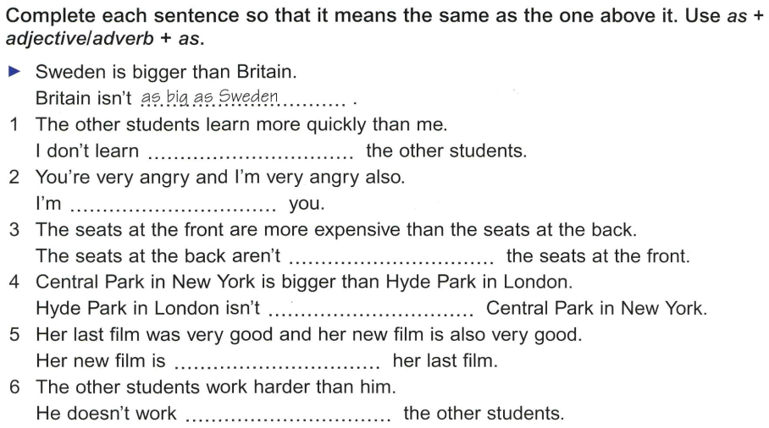
Unit 7: DANGER
Lesson 2: Not as dangerous as you think
GRAMMAR
Comparison: (not) as … as

Slide 20
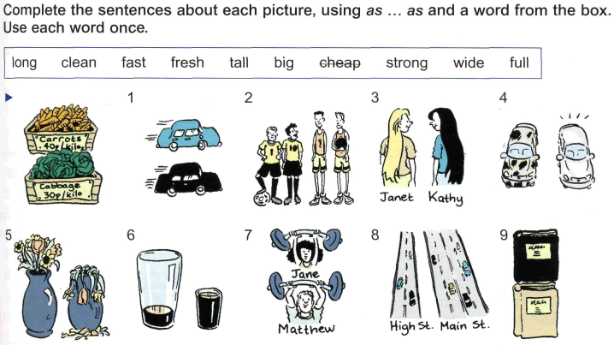
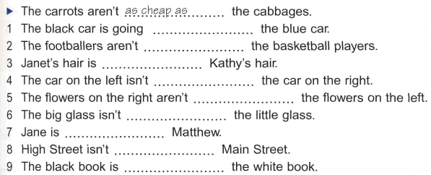
Unit 7: DANGER
Lesson 2: Not as dangerous as you think
GRAMMAR
Comparison: (not) as … as

Slide 21
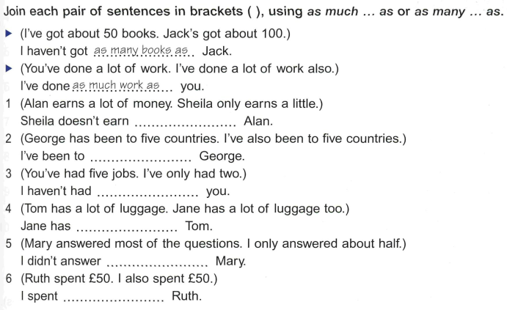
Unit 7: DANGER
Lesson 2: Not as dangerous as you think
GRAMMAR
Comparison: (not) as … as

Slide 22
Online Game
Comparison: (not) as … as

Slide 23
References
Grammar: Equal comparison
https://www.youtube.com/watch?v=-6zIumhE9cE
https://www.youtube.com/watch?v=CCPDFgdaSkI
Listening
https://www.youtube.com/watch?v=WnD3QgYSuZs
Reading
https://www.youtube.com/watch?v=yAoeqBwovPo

Slide 24
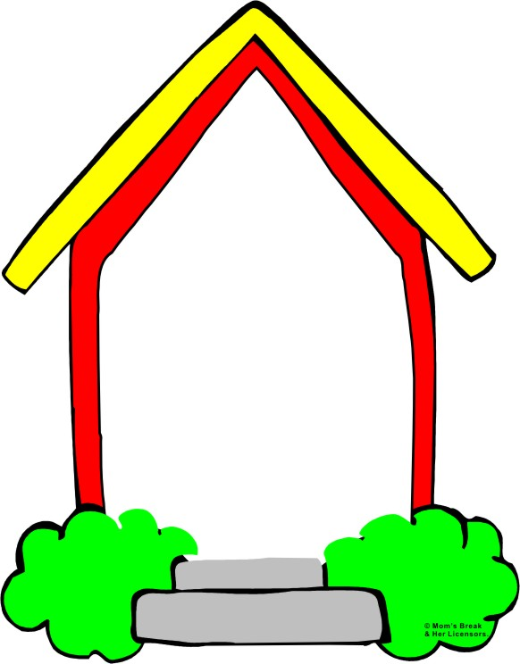
HOMEWORK
Do the exercises in Workbook

